Slide 1
Pulsar Timing Array
Andrea Lommen
IPTA Pune, India 2019

Slide 2
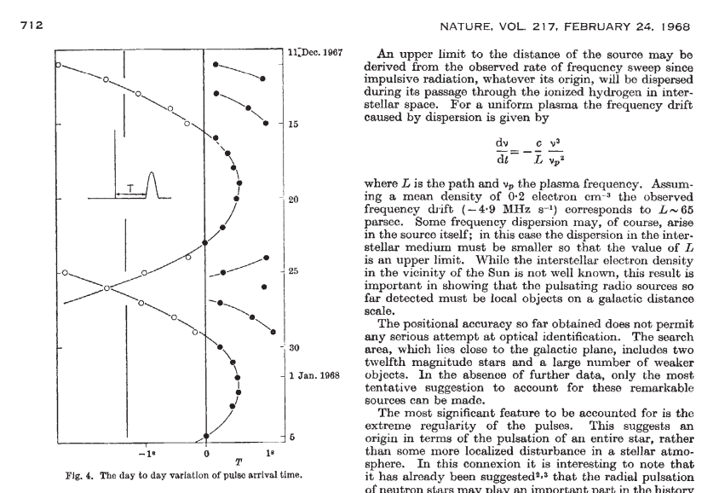
We’re just past half-way through the week. What’s happened so far?
Gravitational Waves hypothesized (Albert Einstein 1915)
Gopu this morning
Neutron Stars hypothesized (Baade and Zwicky 1933)
Dipankar Bhattacharyaa on Monday
Pulsars discovered (Bell and Hewish et al 1968)
Pulsars timed (Bell and Hewish et al 1968)
Tim Pennucci (lecture and PINT demo) and Golam (tempo2 demo on Tuesday), Golam, Renee, Avishek, Sarah (psrchive)
Millisecond Pulsars discovered (Backer et al 1982)
Gravitational Waves Discovered (LIGO 2016)
Gopu this morning

Slide 3
What’s next?
Really good tea
Really good food
A Bayesian analysis extravaganza tomorrow (Mihir, Aditya, Marcus, Yanjun, Abhimanyu) This is where you’ll learn how to deal with all the problems I tell you about today.
All the other cool stuff you can do with pulsar timing (Maura on Friday)
Student presentations!

Slide 4
THE PLAN
Put the pieces together, i.e. how do you use pulsars to detect gravitational waves?
Really handwaivey. (Same version I’ll give in my public talk on Friday evening - you’re invited!)
Somewhat deeper. (Includes the effects of polarization, that you just learned about from Gopu)
The annoying version. Learn how your ability to detect gravitational waves depends upon your ability to model the noise.

Slide 5
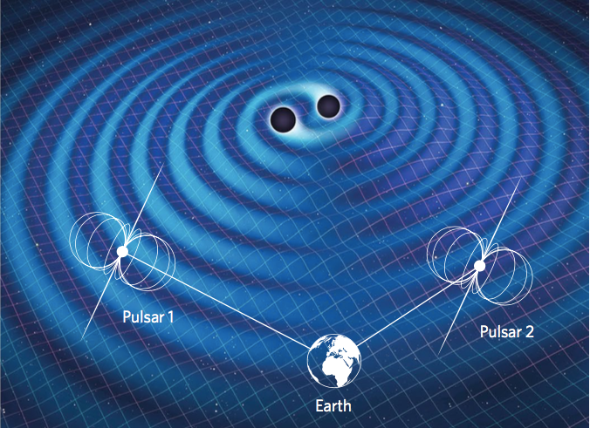
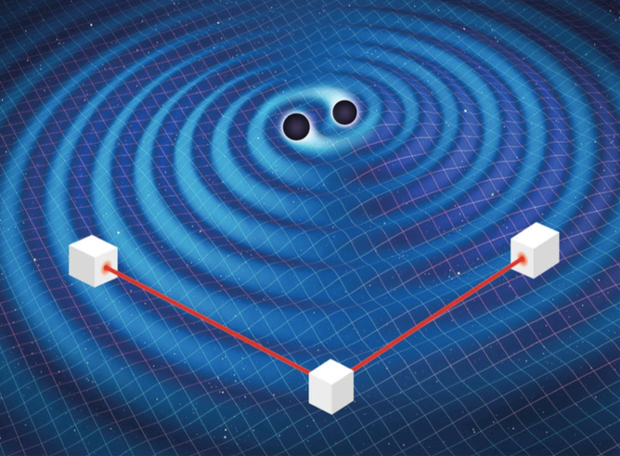
From an issue of Nature Astronomy with cool pulsar articles by several people here or who will be here next week: Maura McLaughlin, Chiara Mingarelli, me
https://www.nature.com/natastron/volumes/1/issues/12

Slide 6
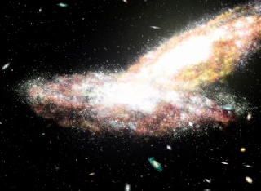
Notes:
The bottom image is B0402+379 (VLBA image). The compact images just below center are likely black holes which are in orbit around each other, and which we would expect to merge in some millions of years.

Slide 7
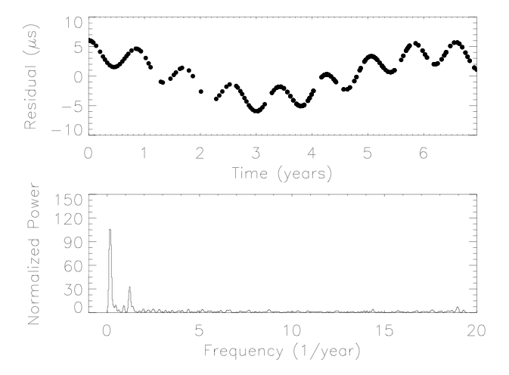
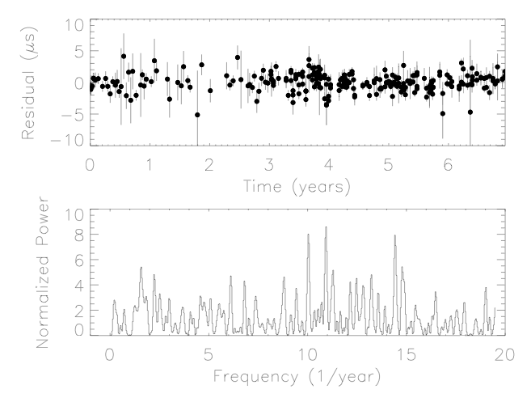
Orbital Motion in the Radio Galaxy 3C 66B: Evidence for a Supermassive Black Hole Binary Sudou, Iguchi, Murata, Taniguchi (2003) Science 300: 1263-1265.
Constraining the Properties of Supermassive Black Hole Systems Using Pulsar Timing: Application to 3C 66b, Jenet, Lommen, Larson and Wen (2004) ApJ 606:799-803.
10
10
0
0
Residual(μs)
Residual(μs)
-10
-10
Simulated residuals due to 3c66b
Data from Kaspi, Taylor, Ryba 1994

Slide 8
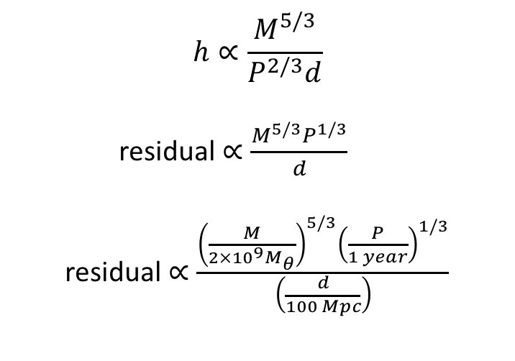
A sense of what’s detectable
For an equal mass binary of mass M, period P, and distance d, the strain h is:
$$h∝\frac{M^{5/3}}{P^{2/3}d}$$
residual$∝\frac{M^{5/3}P^{1/3}}{d}$
residual$∝\frac{{\left(\frac{M}{2×{10}^{9}M_{θ}}\right)}^{5/3}{\left(\frac{P}{1 year}\right)}^{1/3}}{\left(\frac{d}{100 Mpc}\right)}$
Gopu showed you that this morning!
Multiply strain by orbital period to get residual.
Do that funky thing astronomers love doing where they express everything as a fraction of some numbers they like.

Slide 9
If I want to use a telescope to observe a binary pulsar and use my TOAs to search for gravitational waves from a system that I suspect has 2 billion-solar-mass black holes orbiting around each other, which of the following do I need to know?
Pop Quiz #1
The period of the GW (for a circular system this is half the binary black hole orbit)
The period of the pulsar rotation (spin period or pulse period)
The period of the electromagnetic wave emitted by the pulsar.
The period of the pulsar’s orbit around its companion (aka the orbital period)
The period of the earth around the sun.
The period of Jupiter around the sun.
The frequency spectrum of the noise.

Slide 10
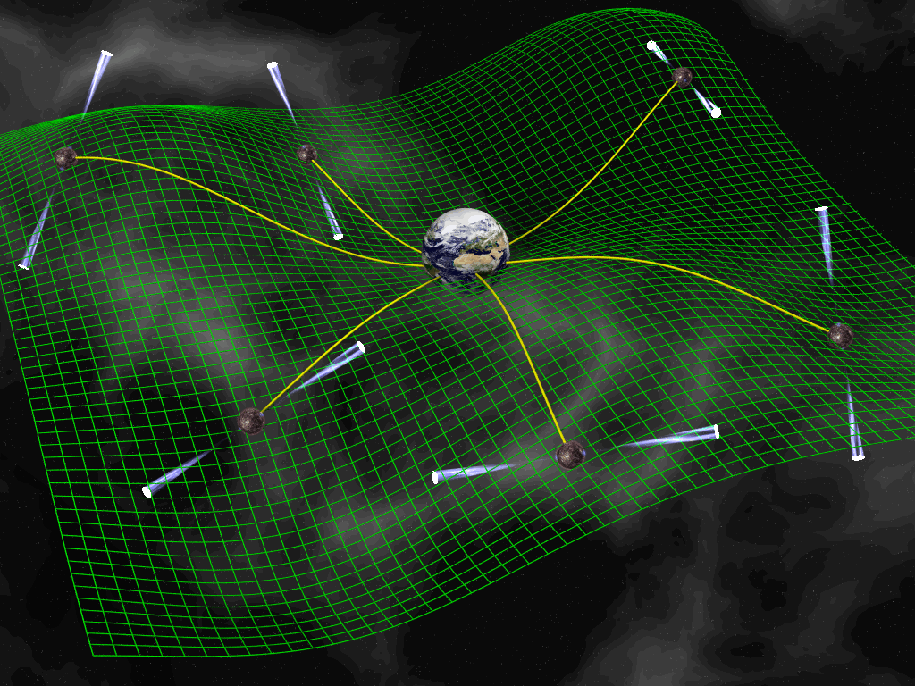
[image: D. Champion]
How does this “array” actually help us?
The effect on different pulsars will be different depending upon their directional relationship to the gravitational wave.

Slide 11

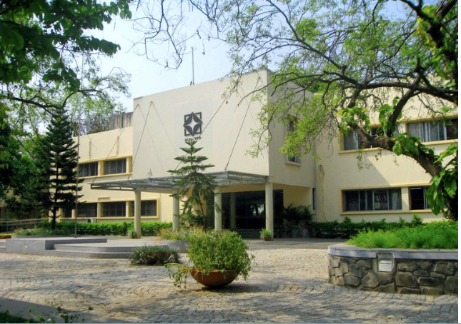


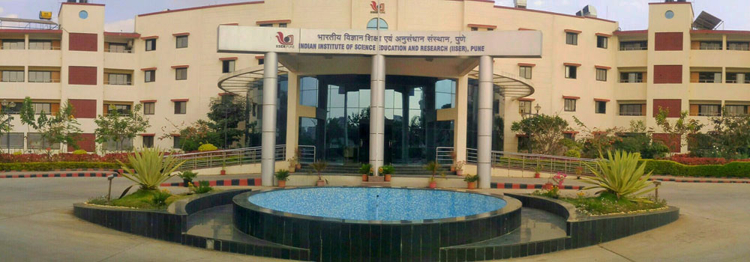
Earth and Pulsar Terms
μ
d
Delay = (d/c)(1 – cos μ)
See the Reports on Progress in Physics article for expanded version of this
Thanks to Tim Pennucci for inspiration.

Slide 12
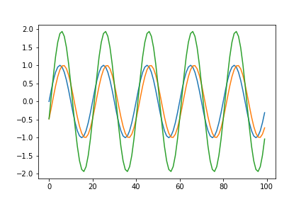
Earth and Pulsar Terms
Blue is the earth term.
Orange is the pulsar term.
Green is the sum of the two, and is what we would observe.
From Lommen & Mingarelli, in prep

Slide 13
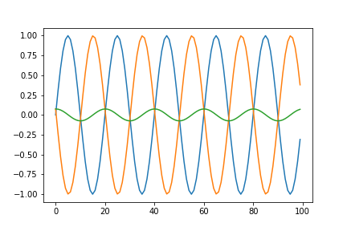
Searching for single sources of GWs
Blue is the earth term.
Orange is the pulsar term.
Green is the sum of the two, and is what we would observe.
From Lommen & Mingarelli, in prep

Slide 14
The deepest, most annoying level
Noise
Pulsars are weak. Jim McKee talked about radiometer noise. Also called measurement noise.
Intrinsic noise. Dipankar discussed this. He showed single pulses from a pulsar that did not occur at the same time each pulse.
The way we deal with the different shape of the pulse at different frequencies. Tim is the expert on this.
ISM noise. We try to correct for it, but some is still left. (See Jesse and Sergio’s poster next week.)

Slide 15
Noise
Three ways of dealing with noise
Integrate it down (observe a lot of pulsars)
Reduce it
Find pulsars with less noise
Do really fancy things like Tim mentioned yesterday about dealing with wide-bandwidth systems.
Improve ISM mitigation – Dan Stinebring is talking about this next week
Model it
Bayesian analysis: Enterprise, Temponest

Slide 16
Sources of noise
I created a Jupyter notebook that all the following slides are from. I’ll make it available at the end of the lecture and you can play with it if you wish! It’s pretty fun running it again and again and looking at the different realizations of the noise.

Slide 17
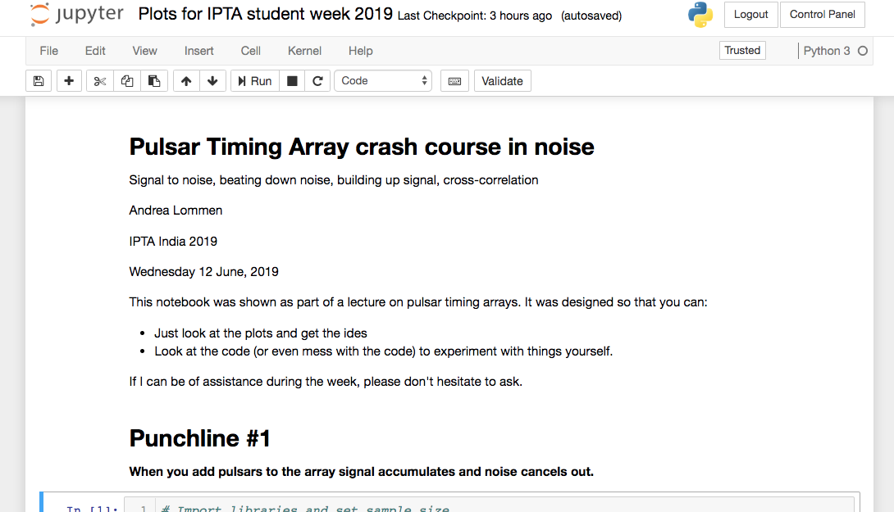

Slide 18
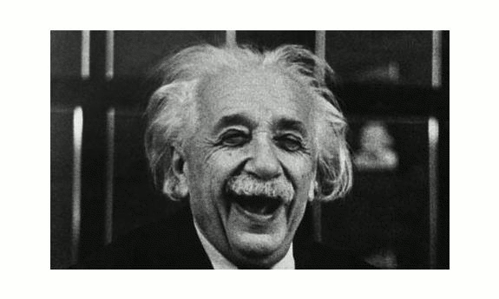
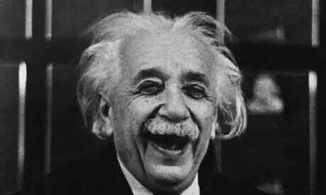
Pop Quiz #2: If a suinsoidal gravitational wave is traveling through the back of Einstein’s head out the front, what will happen to his head under the influence of the GW?
Nothing.
His head will get thicker and thinner from back to front.
His head will get longer and shorter.
His head will get wider and narrower.
His head will get both wider and narrower and longer and shorter.
Not enough information given.
Animation: Mark Purver

Slide 19
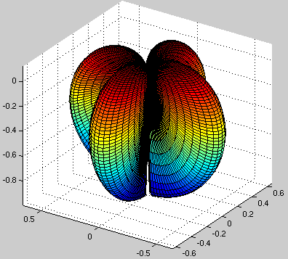
The shape of the GW response
Thanks Bill Coles
Notes:
Not fair to call it an interferometer - the rub is that in the case of an interferometer your resolution goes inversely with the separation of your receivers. With GWs you’re always sampling the same beam pattern. Beam doesn’t get smaller.

Slide 20
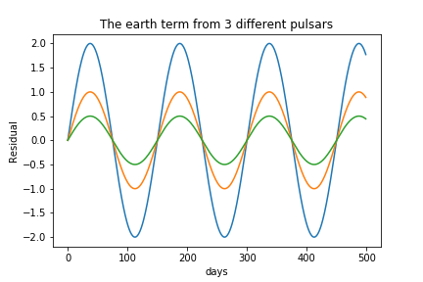

Slide 21
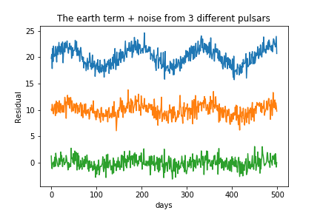

Slide 22
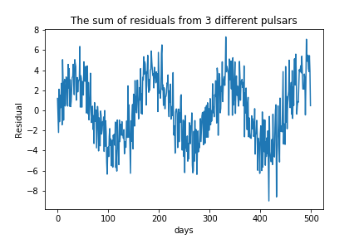

Slide 23
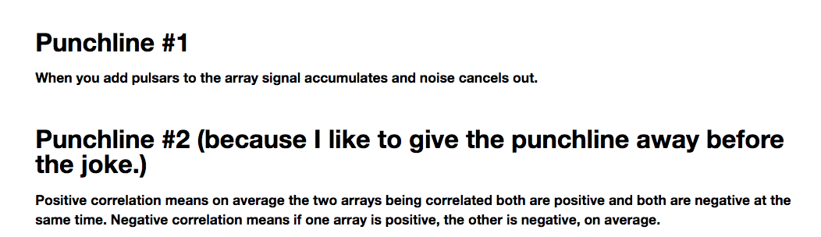

Slide 24
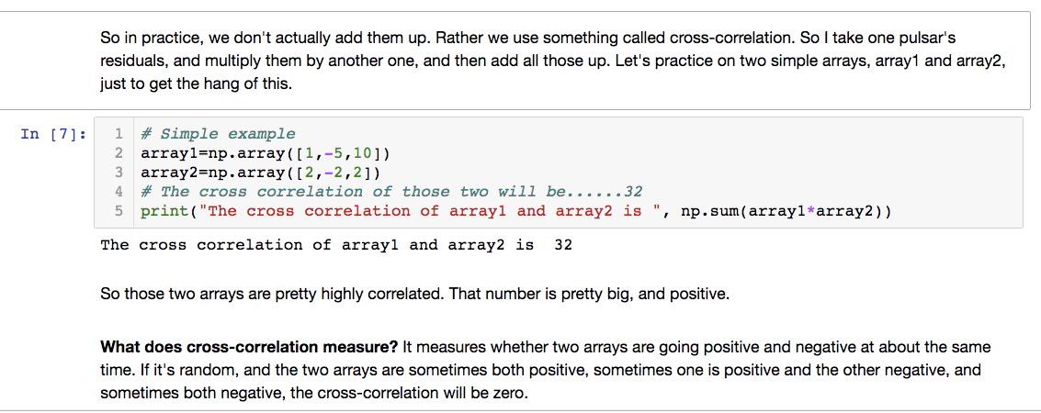

Slide 25
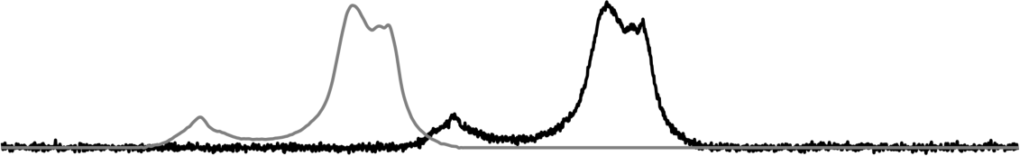
Slide from Tim!
Time-of-arrival (TOA) Measurements
→ Basic idea is a cross-correlation with a template
(cf. “matched filter” or “template matching”)
→ The phase offset ϕ times the instantaneous spin period P_{S} of the pulsar gives a time offset Δt, which is added to the absolute start time of the data profile to obtain the TOA. That's it (almost).
template
data
TOA
ϕ

Slide 26
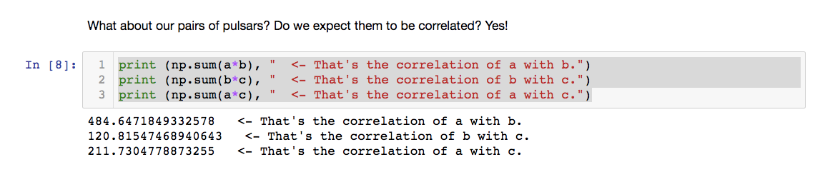

Slide 27
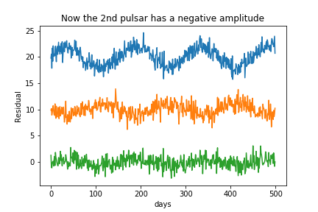
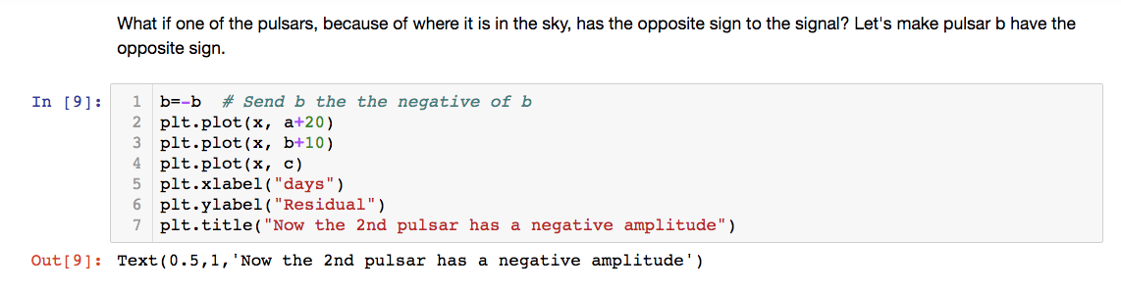
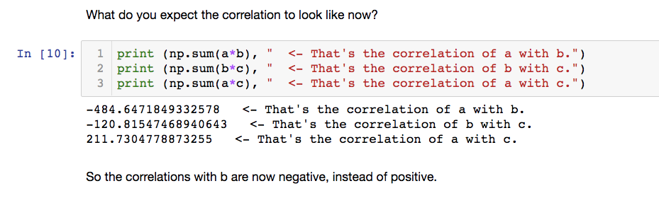
Pop Quiz #3
What do you expect for the 3 correlations?
They’ll all still be positive.
One of them will be positive and two will be negative.
Two of them will be positive and one will be negative.
All of them will be negative.
There’s no way to tell from the information given.

Slide 28
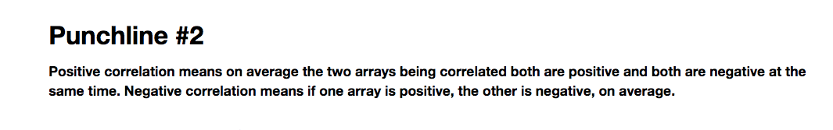

Slide 29
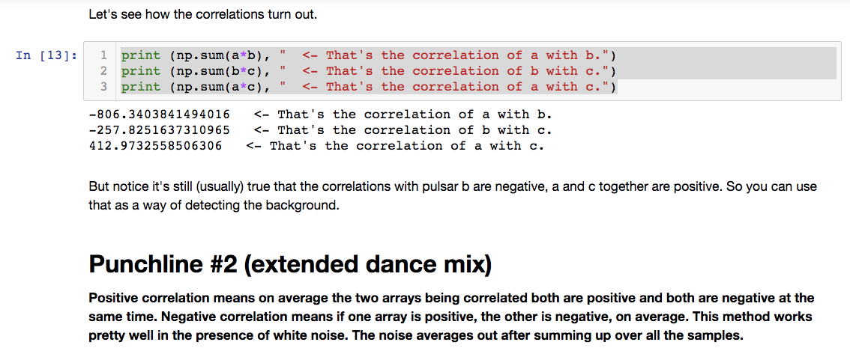
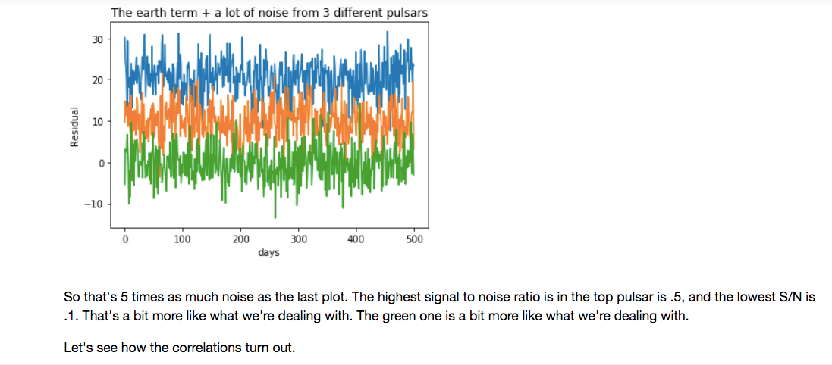

Slide 30
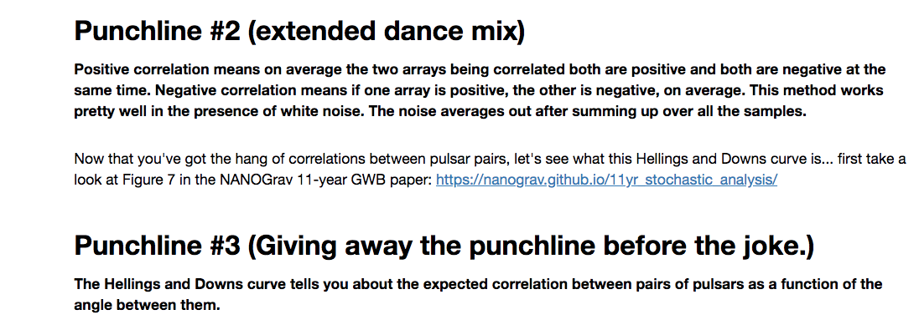

Slide 31
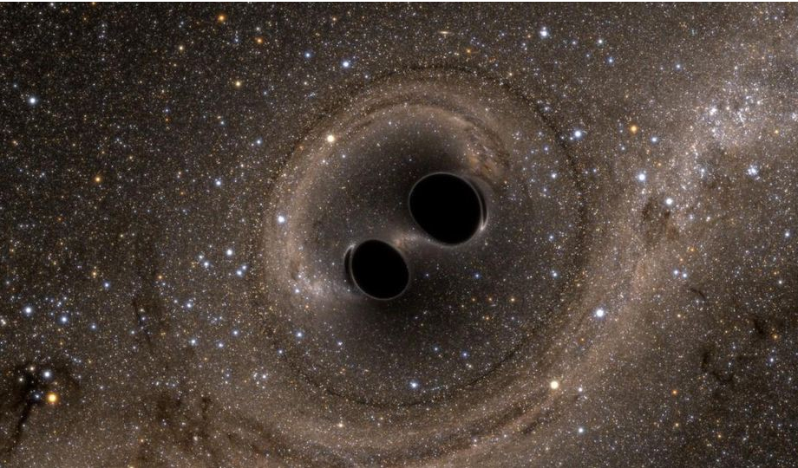
Gravcalc.org
Try it out and tell me what you think!
Gravcalc.org is partly a thesis project by Liam Lynch and Drew Evans, Haverford College.
Illustration from LIGO.

Slide 32
The shape of the GW response
Thanks Bill Coles
Notes:
Not fair to call it an interferometer - the rub is that in the case of an interferometer your resolution goes inversely with the separation of your receivers. With GWs you’re always sampling the same beam pattern. Beam doesn’t get smaller.

Slide 33
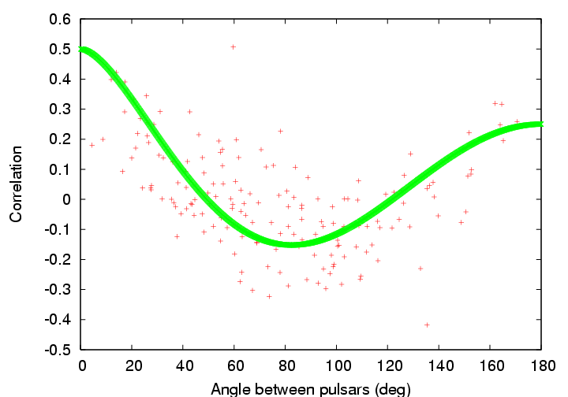
Hellings and Downs Curve
Courtesy of Rick Jenet and George Hobbs. Original figure from Hellings and Downs (1983).
Notes:
So notice that the correlation never gets higher than 0.5. From a pair of pulsars that are in the same direction you can’t expect, on average, better than 50% correlation because of the pulsar term. But over many pairs of pulsars the pulsar term averages out to zero, and you are left with 50% correlation.
You can think about this another way. Remember that shape I showed you about 10 slides ago – the four lobed pattern. This is an average, or a collapsing of that pattern into 2 dimensions, in the following sense. Let’s bring back up that shape (next slide), remember that represents the response to a single gravitational wave traveling in the z-direction, with a particular polarization. Imagine all the ways that you plunk down any two pulsars on that pattern spaced 20 degrees apart. In some cases their residuals will be highly correlated (show a highly correlated pair) and some will be anti-correlated! (show an anti-correlated pair) and there will be everything in between. On average, though, they will be correlated at the 40% level.
Now just to adjust the thought experiment a little bit – we don’t have zillions of pairs of pulsars, we only have 30 or 40, but we imagine that the gravitational waves will be coming from all different directions, which will have the same effect as I described above.
So that’s where the hellings and downs curve comes from.
So if you actually detect the presence of this curve you have detected a stochastic background of gravitational waves. There’s nothing else that could produce this curve.
As a note of interest, there are other possible curves, if GR is not Einsteinian, or more precisely if the polarization is not transverse traceless. Rick Jenet and KJ Lee have a done a lot of work on that and I invite to look at Lee, jenet and Price 2008.
Another note of interest, whether this curve is the input or the output of your analysis is the subject of my talk next week – bayesian vs frequentist methods of stochastic background detection.
Now let’s turn to single source detection – in particular bursts.

Slide 34
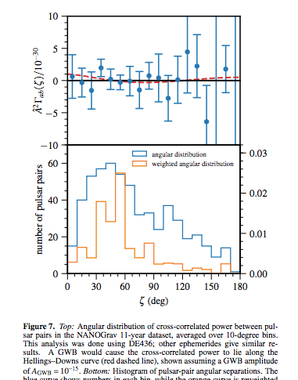
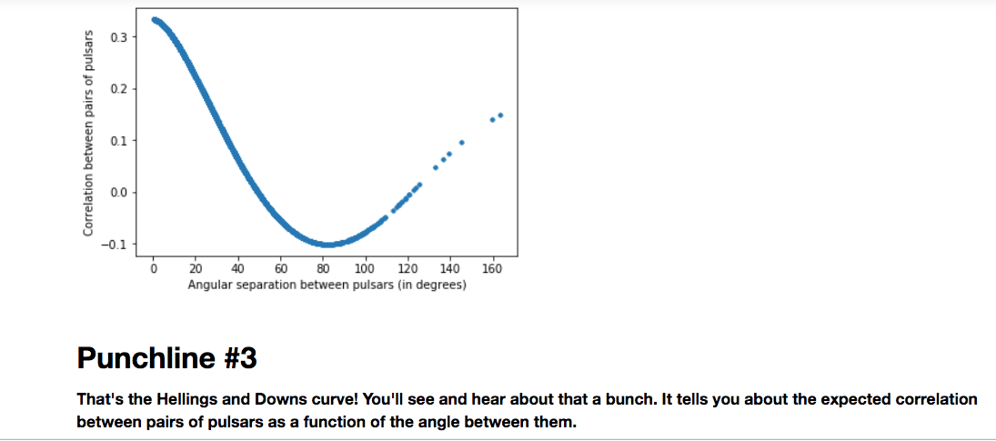
The NANOGrav 11-year paper: The NANOGrav 11 Year Data Set: Pulsar-timing Constraints on the Stochastic Gravitational-wave Background http://adsabs.harvard.edu/abs/2018ApJ...859...47A

Slide 35
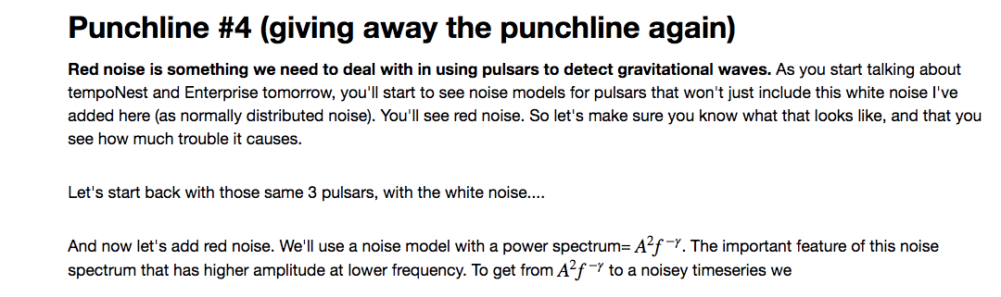

Slide 36
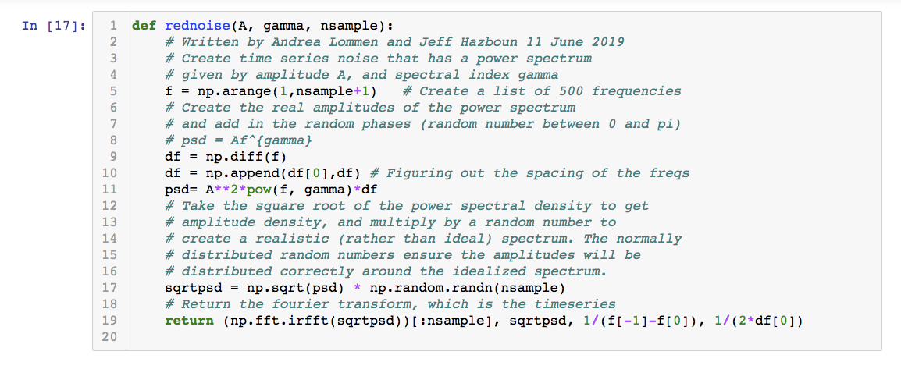
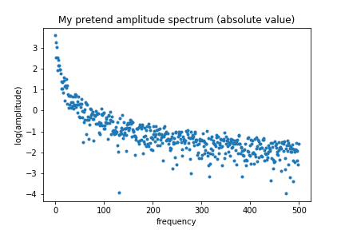
Ergo this is a “red” spectrum and we call the noise “red”.
“Red”
“Blue”

Slide 37
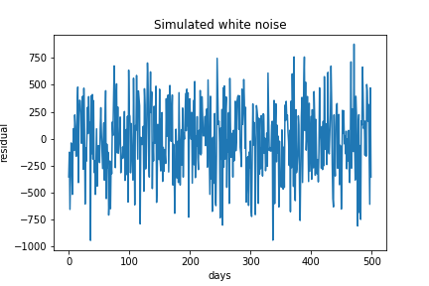
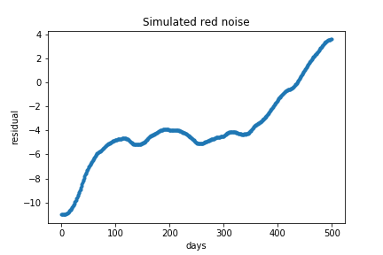

Slide 38
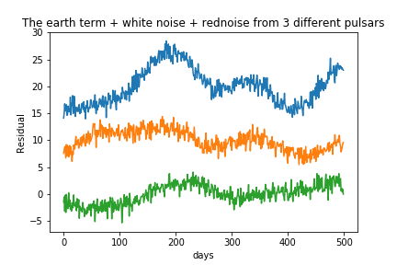

Slide 39
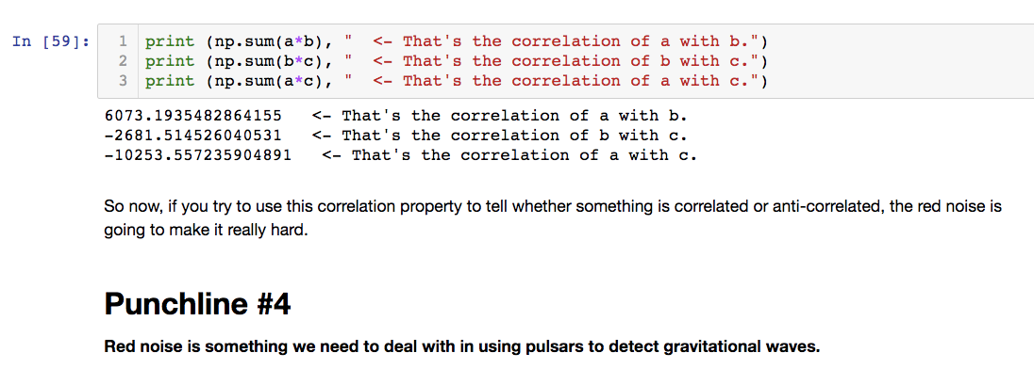

Slide 40
Takeaways
The basic idea of how you can use pulsars as clocks to detect gravitational waves.
A sense of how the polarization leaves a particular imprint on the pulsars that will be distinguishable from other disturbances in the timing.
The Hellings and Downs curve, how it’s made, and what it has to do with polarization.
Familiarity with red and white noise (you should be able to sketch both of them), and why we care so much about them.
Excitement about hearing about Bayesian analysis tomorrow and how it can help you deal with all the challenges I just told you about.

Slide 41
If you want to read or do some more stuff…
https://github.com/ipta/ipta-2019-workshop <- NoiseCrashCourse_Lommen.ipynb You can goof around with the notebook I used to make the plots you just saw.
Pulsar timing arrays: the promise of gravitational wave detection, Andrea Lommen, Reports on Progress in Physics, Volume 78, Issue 12, article id. 124901 (2015). https://iopscience.iop.org/article/10.1088/0034-4885/78/12/124901/pdf
Pulsar Timing for Gravitational Wave Detection, Andrea Lommen, Nature Astronomy, Dec 1, 2017, volume 1 (It’s actually a special issue about pulsar astronomy, so also see articles by Maura, Chiara….) https://www.nature.com/natastron/volumes/1/issues/12
The NANOGrav 11-year paper: The NANOGrav 11 Year Data Set: Pulsar-timing Constraints on the Stochastic Gravitational-wave Background http://adsabs.harvard.edu/abs/2018ApJ...859...47A

Slide 42
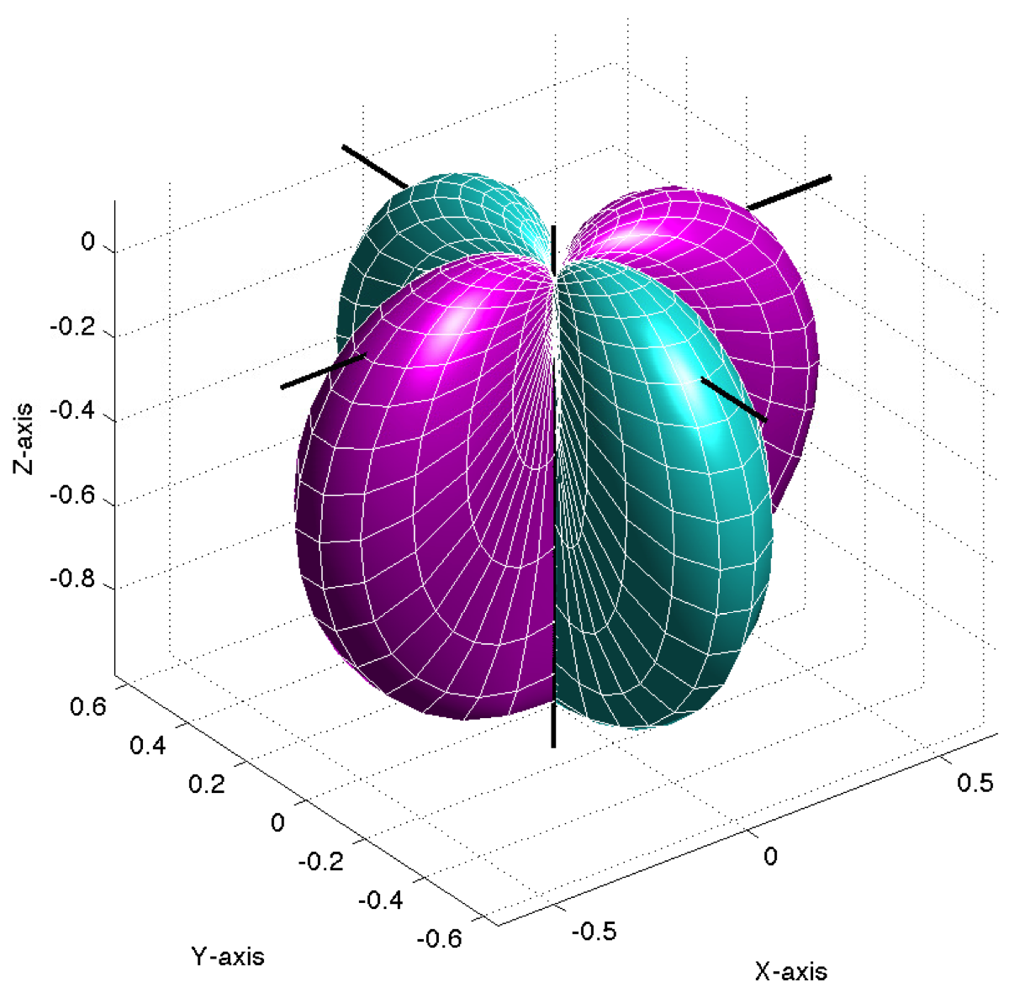
The shape of the GW response
Thanks Joe Romano
Notes:
Not fair to call it an interferometer - the rub is that in the case of an interferometer your resolution goes inversely with the separation of your receivers. With GWs you’re always sampling the same beam pattern. Beam doesn’t get smaller.

